Slide 1
Lesson 7
Passing Data to views

Slide 2
Passing Single Variable
[compact method]
class ProductsController extends Controller
{
public function index(){
$tite = "Welcome to my Laravel Course";
return view('products.index', compact('title'));
}

Slide 3
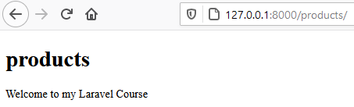
The Key Files and Output
2.web.php
1. Index.blade.php
<!DOCTYPE html>
<html>
<body>
<h1>products</h1>
{{ $title }}
</body>
</html>
// Method 1
Route::get('/products', [ProductsController::class, 'index']);
3. ProductsController.php
{
public function index(){
$title = "Welcome to my Laravel Course";
return view('products.index', compact('title'));
}
4.Output on Browser

Slide 4
Passing Multiple Variables
class ProductsController extends Controller
{
public function index(){
$title = "Welcome to my Laravel Course";
$description = "Created by Hadullo";
return view('products.index', compact('title', 'description'));
}

Slide 5
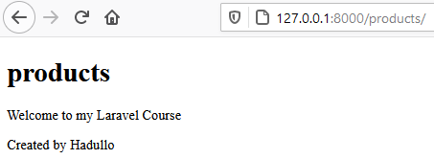
Passing Multiple Variables
1.Index.blade.php
2.web.php
<!DOCTYPE html>
<html>
<body>
<h1>products</h1>
<p>{{ $title }}</p>
<p>{{ $description }}</p>
</body>
</html>
// Method 1
Route::get('/products', [ProductsController::class, 'index']);
3. ProductsController.php
<?php
class ProductsController extends Controller
{
public function index(){
$title = "Welcome to my Laravel Course";
$description = "Created by Hadullo";
return view('products.index', compact('title', 'description'));

Slide 6
Passing Single Variable
[using the with method]
<?php
namespace App\Http\Controllers;
use Illuminate\Http\Request;
class ProductsController extends Controller
{
public function index(){
$title = "Welcome to my Laravel Course";
$description = "Created by Hadullo";
// with method
return view('products.index') ->with('title',$title);
}
}
NB* Name of variable $title and place holder name title must be identical
with method suitable if passing only one variable
Very suitable when passing arrays

Slide 7
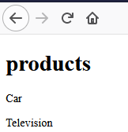
Passing Array Variable
[using the with method]
1.ProductsController.php
2.Index.blade.php
class ProductsController extends Controller
{
public function index(){
$title = "Welcome to my Laravel Course";
$description = "Created by Hadullo";
$data = [
'productOne' => 'Car',
'productTwo' => 'Television'
];
// with method
return view('products.index') ->with('data',$data);
}
}
<body>
<h1>products</h1>
@foreach ($data as $item )
<p>
{{ $item }}
</p>
@endforeach </body>
http://127.0.0.1:8000/products/

Slide 8
Passing Array Directly in view
1.ProductsController.php
class ProductsController extends Controller
{
public function index(){
$title = "Welcome to my Laravel Course";
$data = [
'productOne' => 'Car',
'productTwo' => 'Television'
];
// with method
//return view('products.index') ->with('title',$title);
return view('products.index', [
'data' => $data
]);
}
}
2.Index.blade.php
<body>
<h1>products</h1>
@foreach ($data as $item )
<p>
{{ $item }}
</p>
@endforeach </body>
http://127.0.0.1:8000/products/

Slide 9
Route Parameters
Required Parameters
Sometimes you will need to capture segments of the URI within your route.
For example, you may need to capture a user's ID from the URL.
You may do so by defining route parameters:

Slide 10
Route Parameters(cont.)
Route parameters are always encased within {} braces and should consist of alphabetic characters.
Underscores (_) are also acceptable within route parameter names.

Slide 11

Route Parameters(cont.)
<?php
namespace App\Http\Controllers;
use Illuminate\Http\Request;
class ProductsController extends Controller
{
public function index(){
$title = "Welcome to my Laravel Course";
$description = "Created by Hadullo";
$data = [
'productOne' => 'Car',
'productTwo' => 'Television'
];
//
return view('products.index', [
'data' => $data
]);
}
public function show($id){
return $id;
}
}
<?php
use Illuminate\Support\Facades\Route;
use App\Http\Controllers\ProductsController;
Route::get('/products',[ProductsController::class, 'index']);
Route::get('/products/{id}',[ProductsController::class, 'show']);

Slide 12
Route Parameters
class ProductsController extends Controller
{
public function index(){
$title = "Welcome to my Laravel Course";
$description = "Created by Hadullo";
return view('products.index', compact('title', 'description'));
}

Slide 13
The end Thank you

